Slide 1


Slide 2


Slide 3
Tap to spot the differences in these shoes.
wet
blue
old
big
funny
shiny
tall

Slide 4

These shoes are blue.
return

Slide 5

These shoes are wet.
return

Slide 6

These shoes are old.
return

Slide 7
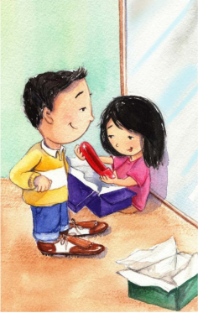
These shoes are big.
return

Slide 8
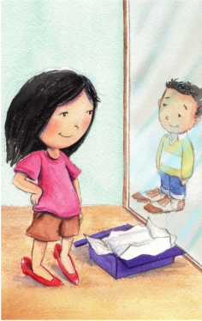
These shoes are shiny.
return

Slide 9
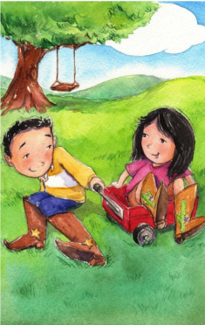
These shoes are tall.
return

Slide 10

These shoes are funny!
return

Slide 11
These shoes are funny!
return

